Slide 1
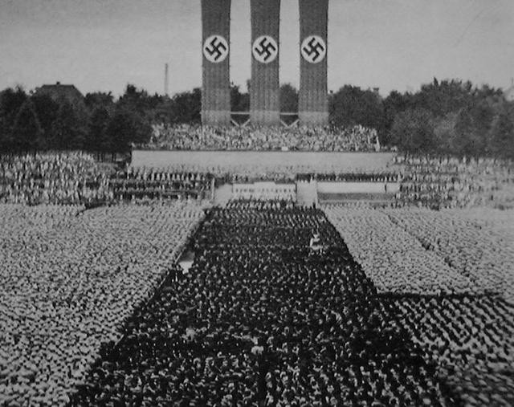
World War II:
The Causes

Slide 2
Directions
With the PowerPoint provided, your task is to hunt for the answers to the following questions on this attachment!

Slide 3
The Dictator’s i.W.A.N.D.
Dictators= The Rise of ABSOLUTE leaders
Absolute control of a government and military
I= Imperialism
The lasting legacy of Imperialism will come back for another round
W= World War I
The resulting Isolationism and Consequences of the Peace Treaty
A= Appeasement
Settling quarrels through negotiation and compromise to avoid conflict
N= Nationalism
Extreme pride in national identity
D= The Depression
The economic troubles facing the world in the 1930’s

Slide 4
I=Imperialism
Japanese people blame government for Depression, give support and control to Military
Military places emperor Hirohito as the head of state power
Extremely nationalist country
Decide to solve economic problems through expansion
1931: Japanese Army takes Manchuria (despite protests by Japanese govt.)
Area rich in Iron and Coal
Army sets up puppet govt.
DIRECT CHALLENGE TO League of Nations – who protests
Japan ignores protests

Slide 5
W=The Consequences of World War I
Isolationism
The Peace Treaty
The idea that Political rulers should avoid entangling alliances with other nations and avoid all wars not related to direct territorial self-defense.
Americans felt their part in WWI was pointless
European nations were no longer paying back the US
People felt the US was tricked into joining WWI
The rise of Dictators in Europe worried Congress leading them to stay neutral
Some Germans, especially Hitler, hated the government that accepted the terms and blamed several groups (War Guilt Clause)
Germany’s war reparations put it deeper into economic depression and hyperinflation
Some Germans, especially Hitler, wanted to reclaim land that was lost from the treaty
Germany’s military was heavily limited

Slide 6
A= Appeasement
Making concessions in exchange for peace
Germans wanted to claim Sudetenland in Czechoslovakia and threatened to fight for it
France and Britain tell Czech to give up the land in order to maintain peace and avoid war
Will it work?

Slide 7
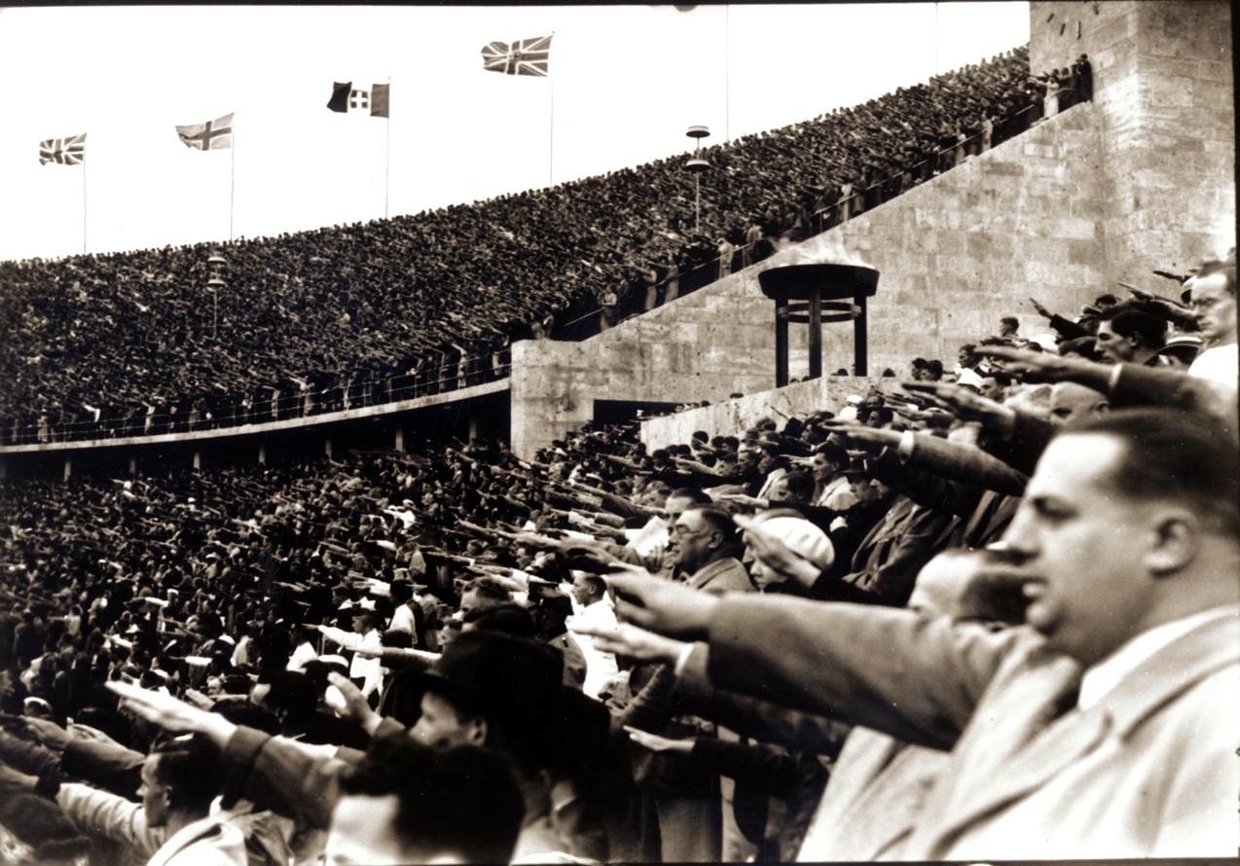
N= Nationalism
Nationalism is the belief that groups of people are bound together by territorial, cultural and ethnic links
Used to gain support for leaders and political movements
Examples?

Slide 8
D= The Depression
Germany faces hyperinflation
160 marks in 1922, 200 billion in 1923
Unemployment makes people angry and want what they don’t have, and Dictators say it’s ok to take it!
Stock Market Crash Hits
America calls in loans to Germany
When going gets tough, blame other people

Slide 9
The Snake Eating Its Own Tail
The Bite of Unemployment
5% of pop earned 33% of income
Remaining families too poor to buy products
Store owners cut back on orders for goods
Factories cut back on production, laid off workers
Unemployed families bought less
Factories shut down (usually in debt)
American Farmers overproduce crops, can’t sell them, can’t pay debts, banks get hurt
Middle-income people and banks start buying stocks with borrowed money
Made money when stock market was up, lost money when it was down
In a fear, everyone sells and the stock market crashes

Slide 10
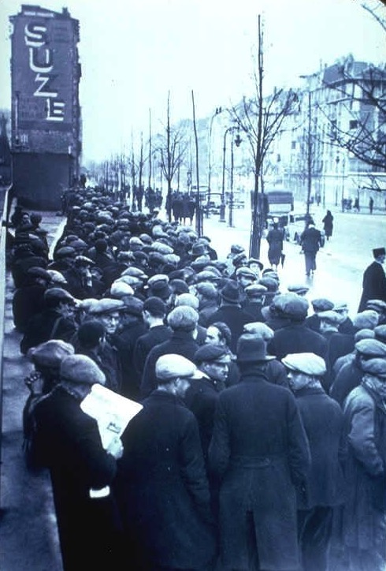
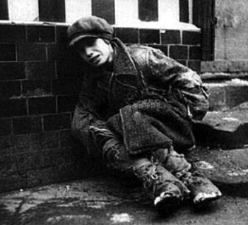
D= The Depression

Slide 11
Totalitanaism…Tota…Totalitainarin…Totalitarianism!
A government that takes total, centralized, state control over every aspect of public and private life
One charismatic leader (will never share power)
Maintain control by:
Police Terror
Paranoia/informers
Great Purge (8-13 million killed), Holocaust
Indoctrination (instruction/education in government’s beliefs)
Children taught from preschool
Teach about ideals of communism/Nazism or face possible death/imprisonment
Propaganda/Censorship/Alteration of History
All media are censored or “repurposed”
Propaganda used to “show positive models”, enforce “cult of personality”
Religious/Ethnic Prosecution
Advocate for atheism (Stalin)
Destroyed religious buildings

Slide 12
Stalin’s Progress Leaves Individual Rights Stallin
Stalin’s total control gives him the ability to create:
Command economy: all economic decisions made by government
Creates high quotas to be met for steel, coal, oil, and electricity
Falls short but makes leaps and bounds in production
Agricultural Revolution
Creates collective farms (government owned massive farms)
Resistance to collective farms leads to 5-10 million peasant deaths
Daily Life
Better education, higher skills, extremely limited personal freedoms and consumer goods
Women gain equal rights & forced to join work force
Get into engineering, science, medicine, and other new areas for women
Motherhood considered patriotic and given government awards for having children

Slide 13
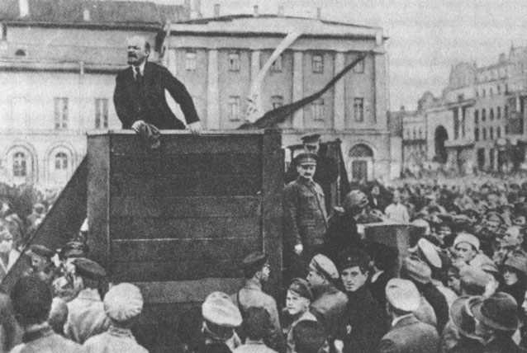
Lenin and Trotsky

Slide 14
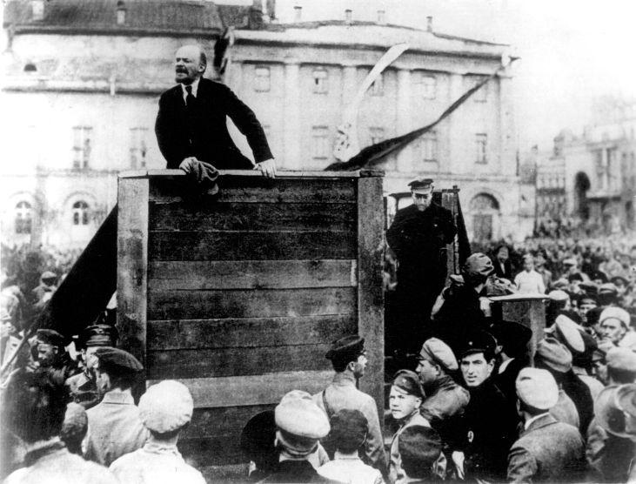
Lenin Alone

Slide 15
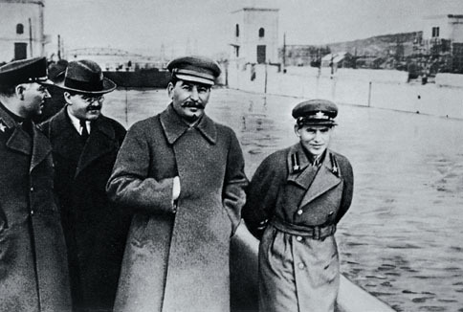
Voroshilov,Molotov, Stalin & Yezhov

Slide 16
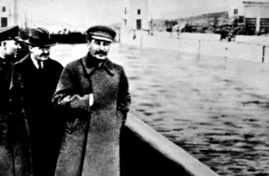
Yezhov executed in Purge – leaves photo

Slide 17
What is a dictator?
A Ruler who assumes sole and absolute power of a government
They are not restrained by any sort of legislative (law making) branch
They can have complete control of the military
Gained power partially due to weak democratic governments that grew after WWI
Dictators may:
Rule by decree (make decisions whenever they want)
Suspend Elections and Civil Liberties
Remove or persecute political opponents
Maintain one single political party
Create a Cult of Personality

Slide 18
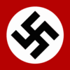
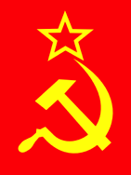
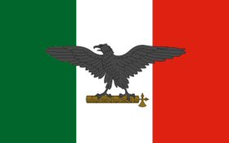
Nazism
Totalitarianism
Communism
Fascism
*These theories, specifically Communism and Fascism, are completely different theories that are bitterly opposed; however they exhibit the same behaviour

Slide 20
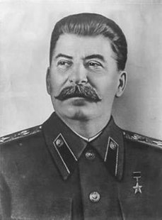
Communism
I am Joseph Stalin, the leader of the Soviet Union from 1922-1953.
What is Communism?
LEFT WING
based on theory by Karl Marx
revolutionary idea of a political, economic and social system that creates a “classless society”
state ownership and control of the means of production (no private ownership)
Soviet Communism or “Stalinism”, was more of a totalitarian and military state combined with elements of communism

Slide 21
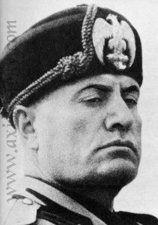
Fascism
I am Benito Mussolini the leader (Il Duce) of Italy from 1922 to 1943.
What is Fascism?
RIGHT WING
intense nationalism and elitism
totalitarian control
interests of the state more important than individual rights
maintain class system and private ownership
No real defined theory or program
Colored uniforms, salutes, mass rallies
Interesting Fact: Fascism name was derived from the fasces, an ancient Roman symbol of authority consisting of a bundle of rods and an ax

Slide 22
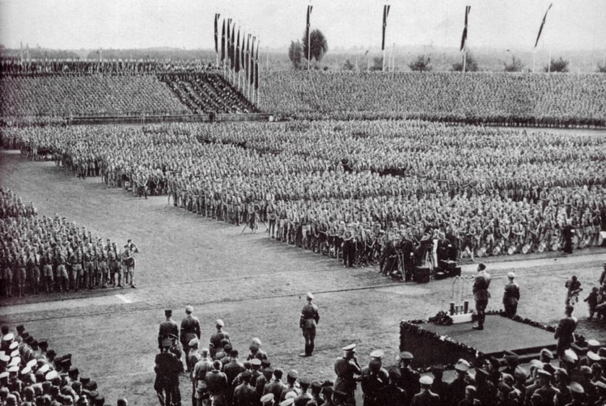
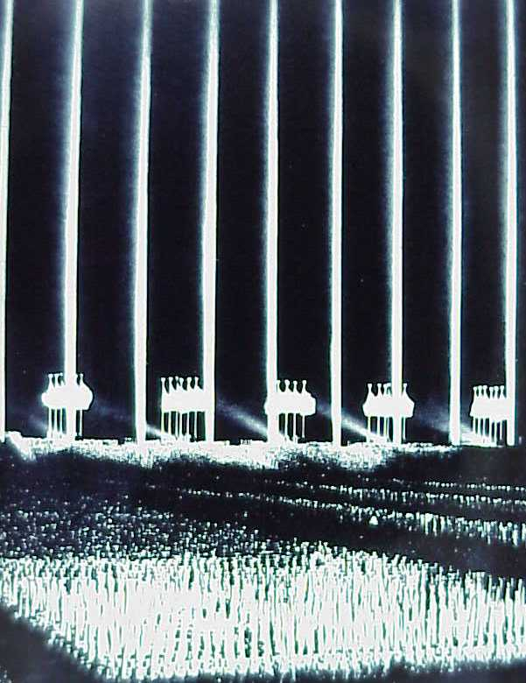
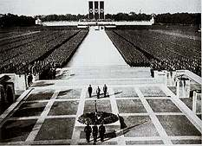
FASCISM –
state supersedes citizen
emphasis on militarism
social contract dissolved & replaced by dictatorship
EXTREME Nationalism - appeal to emotions of population (NUREMBERG RALLIES)

Slide 23
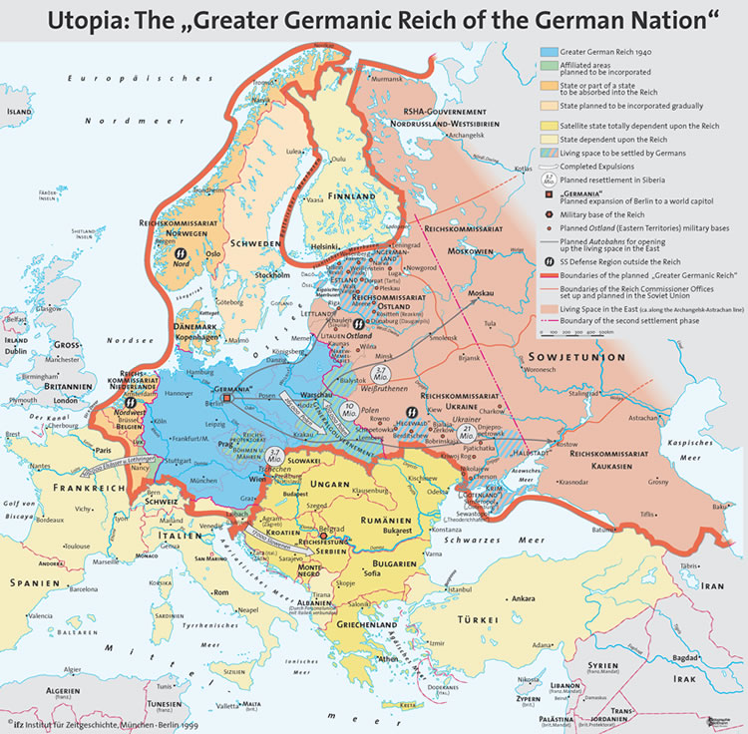
NAZISM for ex. Put emphasis on racism/anti- Semitism absent in Italy
At least initially…. Hitler would pressure Mussolini into passing discrimination in the form of the Race Manifesto (protested by most Italians and Pope)
Imperialism/conquest – to glorify nation & to express cultural superiority
EX: Italian invasion of Ethiopia
Annexing territories based on cultural connection
Hitler in Sudetenland & Austria

Slide 24
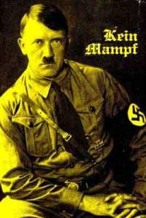
Nazism
I am Adolf Hitler the leader (der Fuhrer) or dictator of Germany from 1933 to 1945.
What is Nazism?
extremely fascist , nationalistic and totalitarian
based on beliefs of the National Socialist German Workers Party
belief in the racial superiority of the Aryan, the “master race”
belief that all Germans should have “lebensraum” or living space in Europe
Violent hatred towards Jews and blamed Germany’s problems on them

Slide 25
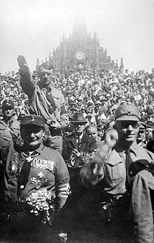
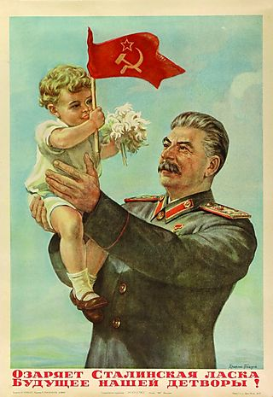
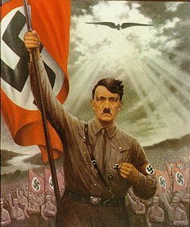
Cult of Personality?
Individual uses mass media to create idealized & heroic public image, often through unquestioning flattery and praise.

Slide 26
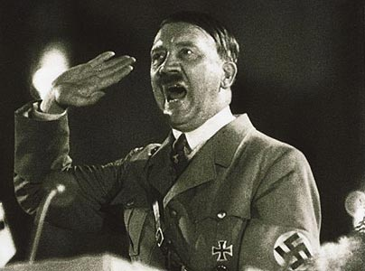
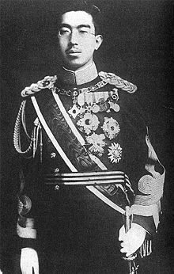
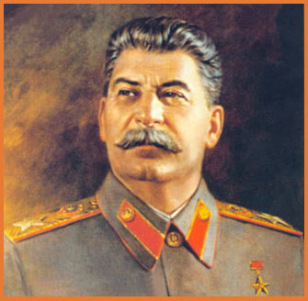
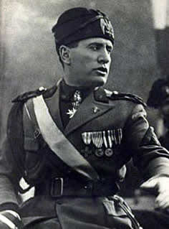
Major Players
Soviet Union’s
Joseph Stalin
Germany’s Adolf Hitler
Italy’s
BenitoMusolini
Japan’s
Emperor Hirohito

Slide 27
Treaty of Versailles
Black Tuesday 1929 - stock market crashes
Great Depression during 1930s
Totalitarianism
Increasing influence of new political parties that emphasize state control -For example: Communism, Nazism, Fascism
Total Control of State by a Dictator

Slide 28
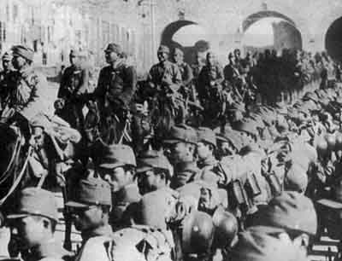
Manchurian Crisis, 1931

Slide 29
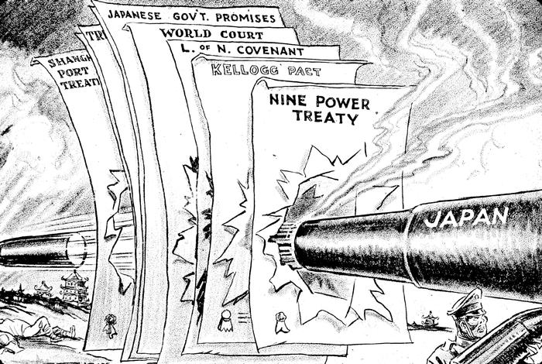
Japan Invades Manchuria, 1931

Slide 30
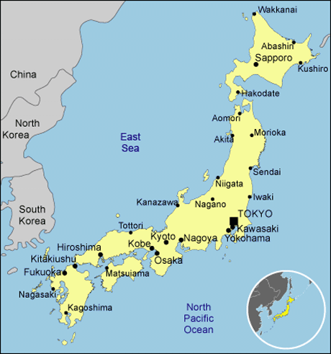
What do you notice
about japan?

Slide 31
Adolf Hitler
Born: April 20, 1889
Home country: Austria-Hungary
Notable background:
Artist
WWI Veteran, wounded twice
(his second wound may have altered his sanity)
Gained German Citizenship in 1932

Slide 32
Adolf Hitler
Gifted Speaker
Gained power through the rise of the National Socialist German Workers’ Party
Attempted to seize power by force, fails
Writes Mein Kampf (My Struggle) in prison

Slide 33
Let’s Get Political…Political
His Struggle
His Plan
Looking to unify all Germans under one government
Believed in a superior race called “Aryans” and the inferiority of a multitude of other races
Needs more space!
Blamed Jews for many of the world’s problems
Rather than using force, he uses politics
Nazis gain tremendous political power in Germany
Gets appointed prime minister and eventually was given dictatorial power, voted in as president, and gave himself his own title: “Der Fuhrer”: The Leader

Slide 34
Hitler Comes to Power Legally … Sort of
Hitler’s party wins largest amount of seats in cabinet but not a true majority –
Hitler has current President Hindenburg to make Hitler chancellor in January 1933 as leader of coalition government

Slide 35
THE REICHSTAG
Fire – blamed on Communists
FIRE in February 1933
Fear… leads to Hitler
gaining more power

Slide 36
POTSDAM Church – HINDENBURG & Hitler
1933 – THIRD REICH…
Mar 21, 1933 – staged photo Former President Hindenburg & Hitler (after Hitler had won in Mar 5 elections) –
Potsdam church – where Prussian kings had been crowned
Hitler chancellor as of Jan. but wanted full majority

Slide 37
DAY OF POTSDAM – HINDENBURG
PHOTO: Hindenburg in full uniform (= mil. tradition)
Hitler in civilian clothes and slightly bowing (thus not military coup)
Goebbels (propaganda minister) wanted to create continuity & more support – fact that all this was in a church further legitimated it –

Slide 38
DAY OF POTSDAM – HINDENBURG
PHOTO: image showed army was ready to accept Hitler – army was what worried him most
So given symbolism, little resistance – legitimacy instead of a revolution!

Slide 39
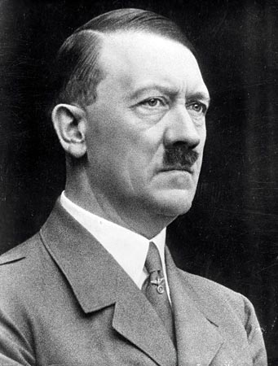
1935
Hitler denounces Versailles Treaty disarmament clauses
Begins open rearmament
Takes control over economy:
Bans strikes, labor unions, takes control of labor
Puts millions of Germans to work building highways, weapons, and serving in the military
Effectively almost ends unemployment and massively boosts economy
Uses Jews and communists as Scapegoats for most of Germany’s problems
Pass Nuremberg laws which strip Jews of their most basic of rights

Slide 40
Defying Authority, Appeasing the Aggressive
Hitler openly defies the Treaty of Versailles
ToV said…
Limited Military
Reparations
Give up land
Begins building a new air force and begins to a military draft to expand the army
League of Nations Reaction: Mild warning, condemnation
Decides to go after the Rhineland (buffer between Germany and France)
Reaction of European leaders:
Negotiation!!!
Why?
Desire to avoid a war
Hitler’s demands were reasonable
Assumption that Nazis would want peace once they got the land they wanted
Result?

Slide 41
Hitler’s Desire to Unify
Hitler had a desire to unify all German speaking countries
Example of…?
Nationalism!
Hitler
Hitler demands Austria, gets it, and unifies it with Germany
Germany then lays claim to the Sudetenland, an area of Czechoslovakia
Uh oh….ALLIANCE SYSTEM ALERT!

Slide 42
ALLIANCE ALERT!
France threatens to fight if Germany attacks Czech…
Soviet Union promises aid….
Britain promises to support France…
WHAT WILL HAPPEN?
They negotiate. Result?
APPEASEMENT

Slide 43
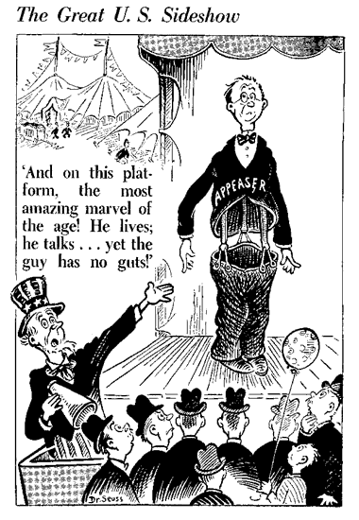

Slide 44
APPEASEMENT ALERT! (The Munich Crisis)
Britain and France believe that by giving Hitler the Sudetenland they could avoid war and maintain peace
Czech is told that they have to give up the land or face Germany alone.
Good intentions, terrible results!
Germany sends troops into Czech and divide the country
…AND HITLER WANTS MORE!

Slide 45
Reactions and Effects
Reactions
Effects
France and Britain are
Happy!
Hitler is…
Furious!
Has no respect for Britain
Russia is…
Changing it’s foreign policy…
Hitler makes more demands of land in Poland
Britain and France offer to defend Poland
Germany and Russia (Nazis and Communists) sign a non-aggression pact so Germany can deal with Britain and France
Germany attacks Poland!

Slide 46
