Slide 1
Globalization
What is Globalization?

Slide 2
Globalization
Definition:
An economic phenomenon?
A social phenomenon?
A cultural phenomenon?
The movement towards the expansion of economic and social ties between countries through the spread of corporate institutions and the capitalist philosophy that leads to the shrinking of the world in economic terms. This then leads to spread of other institutions and philosophies that adhere to this economic model

Slide 3
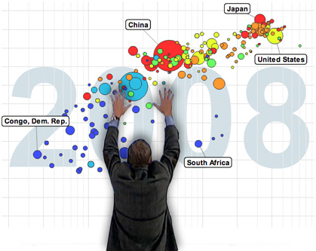
http://www.youtube.com/watch?v=jbkSRLYSojo

Slide 4
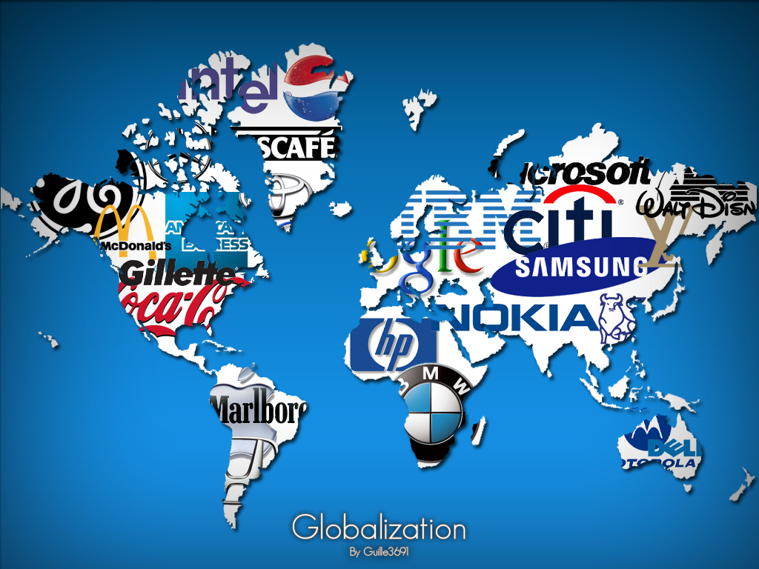
5 ASPECTS OF GLOBALIZATION
ECONOMIC
TECHNOLOGICAL
CULTURAL
POLITICAL
MILITARY
THESE ASPECTS ARE ALL INTERCONNECTED!
*********************

Slide 5
Globalisation
Globalization could involve all these things!

Slide 6
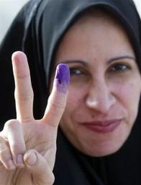
Globalization: Social and Political Affects
In the past 3 decades 650 billion more people now live in politically “free” countries which results in access to
Social Justice and Civil Rights/liberties
Democracy and voting rights
Education and healthcare

Slide 7
Negative Effects
Some social issues continue to exist in the globalized world. Some in spite of it and some because of it
Ethnic tensions and genocide
Forceful acquisition of and resources
Epidemics and disease
Terrorism

Slide 8
Terrorism
As we look at different clips of terrorism in a modern context, reflect on the following question thoughtfully and we will discuss throughout the clips:
How and why would a terrorist justify the 9/11 attacks as their response to a rapidly globalizing world?
Some may say that terrorists attacks are isolated incidents. Yet throughout our lifetimes, nations have continued to further embrace globalization as terrorist attacks become more frequent all over the world. What is your perspective, and justify it with your own experiences.

