Slide 1
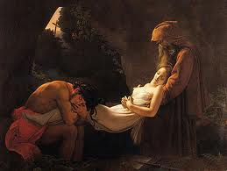
Revolutions in the Arts

Slide 2
The Romantic Movement
After great revolutions, artists focused on the “realistic” view of life.
Romanticism – following the Enlightenment, romanticism focused on emotions of the individuals and nature
Nationalism fueled romantic artists

Slide 3
Ideals of Romanticism
Found in painting, music, poetry, and gothic novels
Emphasized inner feelings, emotions, and imagination.
Focused on mysterious, supernatural, exotic, horrifying
Loved beauties of untamed nature
Idolized the past and a simpler time
Glorified heroes
Folk traditions
Valued common people
Promoted change and democracy

Slide 4
Realism
A response to the tough, everyday life of industrialized Europe.
As life is, not necessarily as it should be
The plight or workers
Paintings, photography, and literature

Slide 5
Impressionism
Impression of a subject or a moment in time
Positive view of urban life
Found in both paintings and composition
Light and the human eye

Slide 6
Now its your turn
Choose one style of art; Realism, romanticism, or Impressionism
Create your own piece of art the clearly represents your style (appropriate please)
Write a short paragraph that explains what your piece of art is and how it depicts your respective style of art

