Slide 2
Renaissance Learning Goals
I can describe the characteristics of the Renaissance and understand why it began in Italy.
I can identify Renaissance artists and writers and explain how new ideas (Humanism) affected the arts of the period.
I can explain how the printing revolution shaped Europe society.

Slide 3
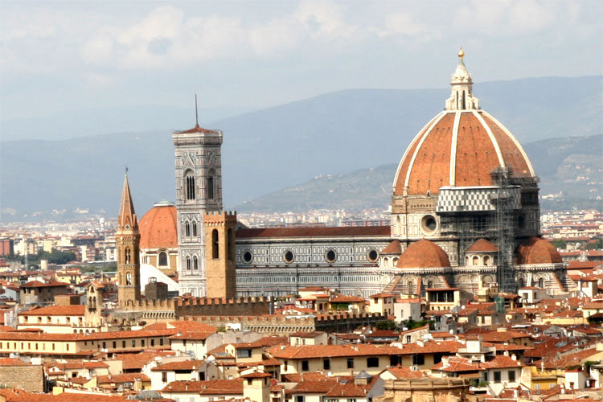
Renaissance: Rebirth
Approx. 1300-1600
(Note: Middle ages 500-1500)
Renewed interest in education & art
Emphasis on individual
Classical Roman & Greek Influence

Slide 4
Why did the Renaissance start in Italy?
Thriving city states - wealthy merchants
Historical connections to classical Rome and Greece
Easy access to trade. Why???
Cultural Diffusion! With who???

Slide 5
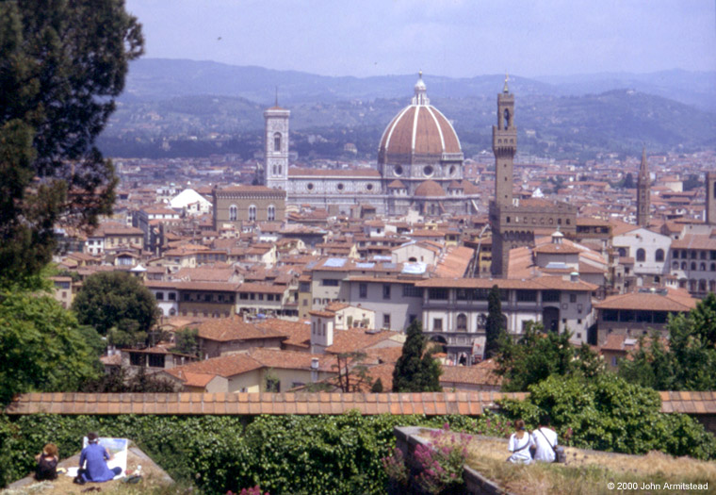
Renaissance Florence

Slide 6
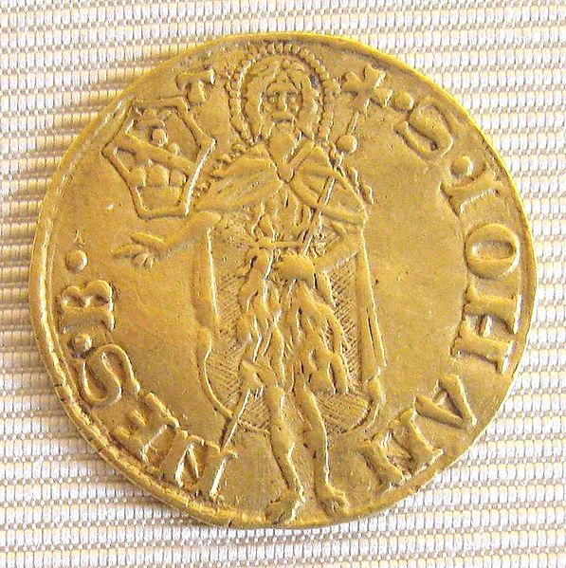
Renaissance Florence
1252 – first gold florins minted

Slide 7
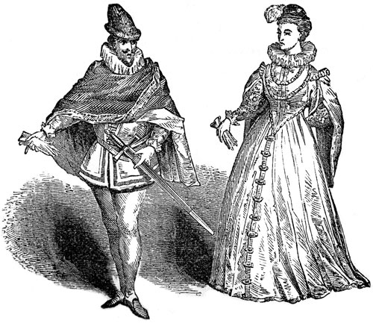
Renaissance Man/Woman:
Renaissance Man: Ideal individual man excels in wide range of studies
Based on classic Greek ideal man
Renaissance Woman: study classics, be charming, and inspire art

Slide 8
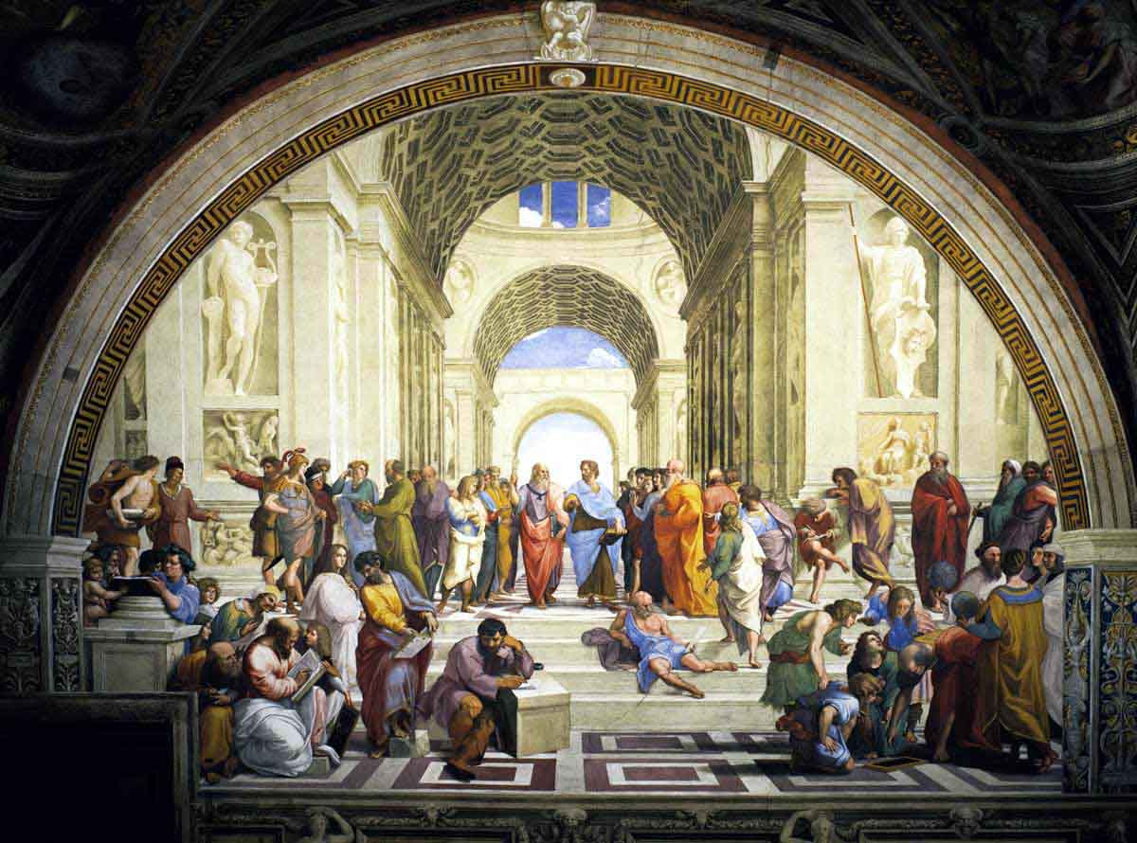
Humanism Philosophy of Renaissance
Centered around what humans were capable of & what they achieved
Studied classical works for inspiration without trying to make them fit with Christianity

Slide 9
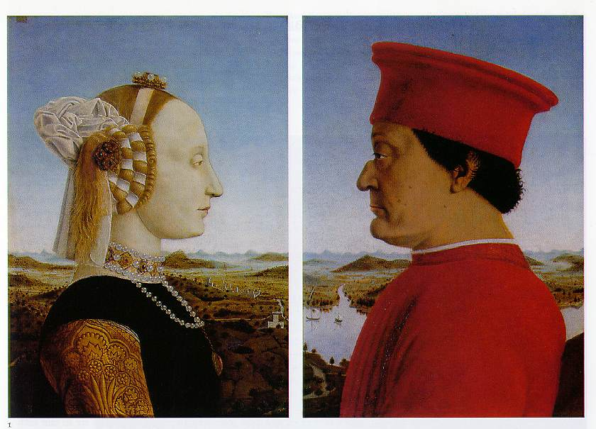
Emphasis on Individualism
Batista Sforza & Federico de Montefeltre: Duke & Dutchess of Urbino
Piero della Francesca, 1465-1466.
Patrons – Portraits

Slide 10
Patrons:
Church leaders & wealthy merchants financed artists- commissioned art
Church leaders decorated cathedrals
Merchants showed off by having portraits done or donating public art.
Commissioning of art = competition for social & political status!

Slide 11
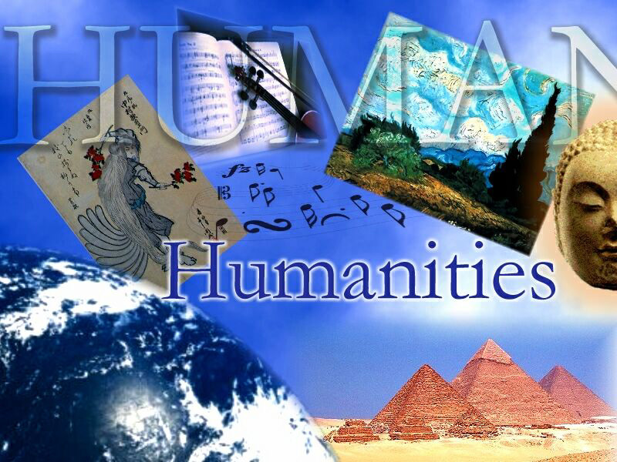
Humanism:
Intellectual philosophy of Renaissance Common subjects: literature, philosophy, history aka the Humanities

Slide 12
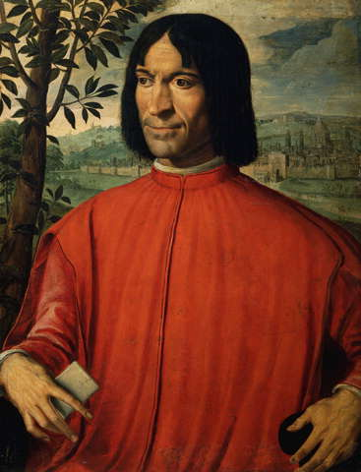
Secular:
From Latin Saecularis – worldly or heathen
Focus on human world
not religion
Renaissance = secular
focus
Lorenzo Medici –
wealthy banker

Slide 13
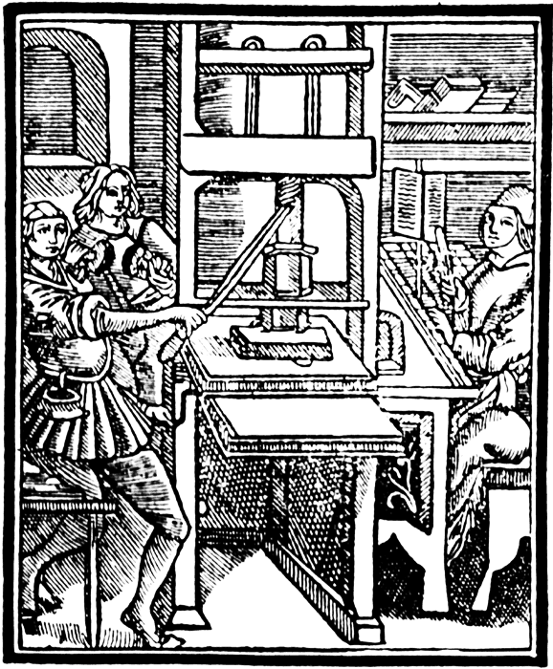
What did Johann Gutenberg Invent?

Slide 14
Changes of Renaissance
Printing press – increases learning as more have access
Published accounts of new discoveries, fuel interest
Ancient Greek idea of questioning leads thinkers to question political structure and religious practice
Increased wealth from improved trade funds exploration
Reading bible in original Greek & Hebrew leads to reformation

Slide 15
Perspective in Art:
Using techniques to create illusion of 3D in 2D painting
Ways to create perspective….
Note: artists were paid to paint portraits by patrons …. but wanted to show off perspective skills – often portraits are in front of windows with landscapes behind ….

Slide 16
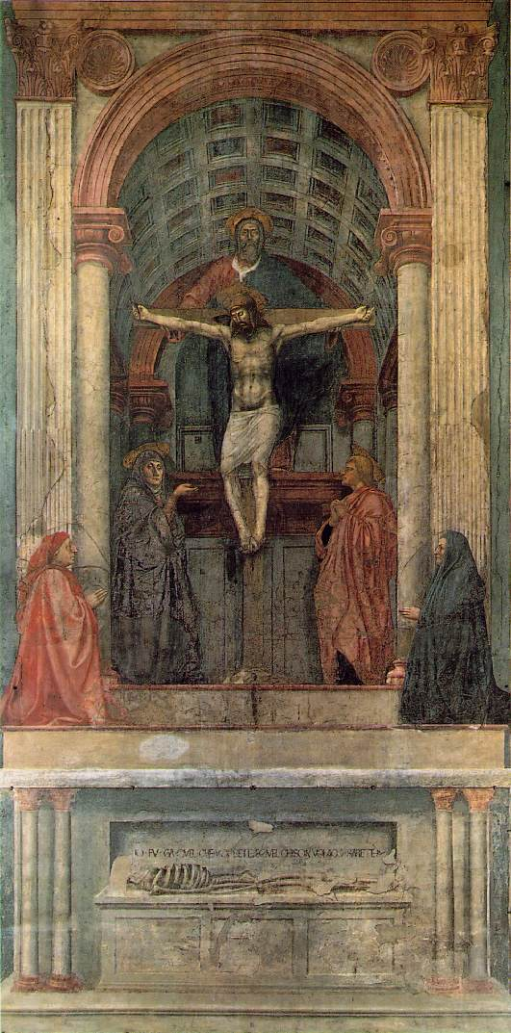
Linear Perspective
The Trinity
Masaccio 1427
Fresco, Santa Maria Novella, Florence
First use of linear perspective!

Slide 17
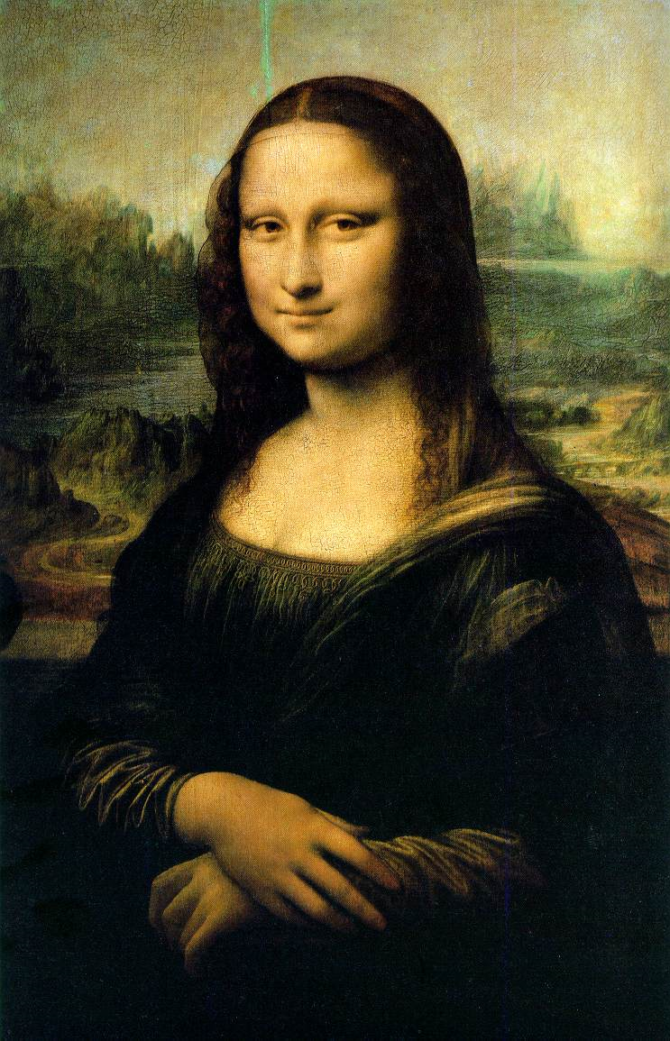
Leonardo Da Vinci 1452-1519
Famous painting…
Perspective – light shadowing/softening edges
Scientist (anatomy)
Inventor
Architect
Engineer

Slide 18
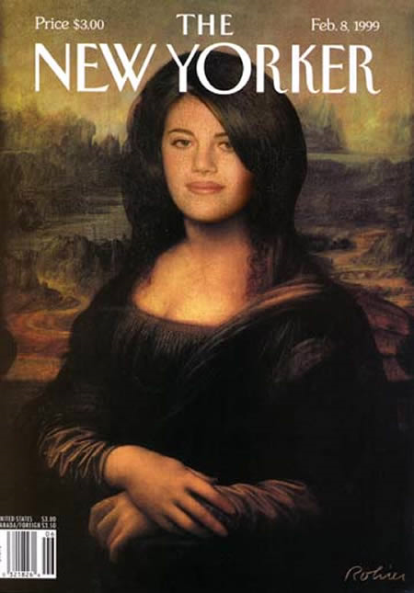
Mona Lisa and Pop Culture

Slide 19
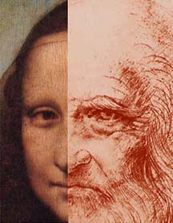
Mona Lisa OR da Vinci??

Slide 20
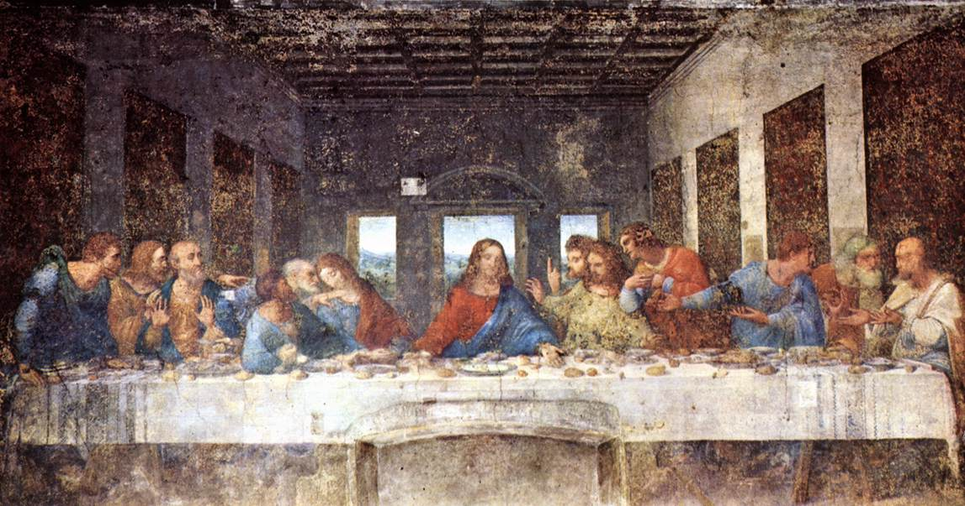
The Last Supper - da Vinci Geometry
Bartholomew, James, Andrew
surprised
Judas, Peter, John
Jesus
Thomas, James the Greater, Philip
Matthew, Jude, Simon

Slide 21
Michelangelo Buonarroti
Renaissance Man– painter
sculptor, architect, poet
Greatest Works:
Sistine Chapel
David Statue
Pieta – St. Peters

Slide 22
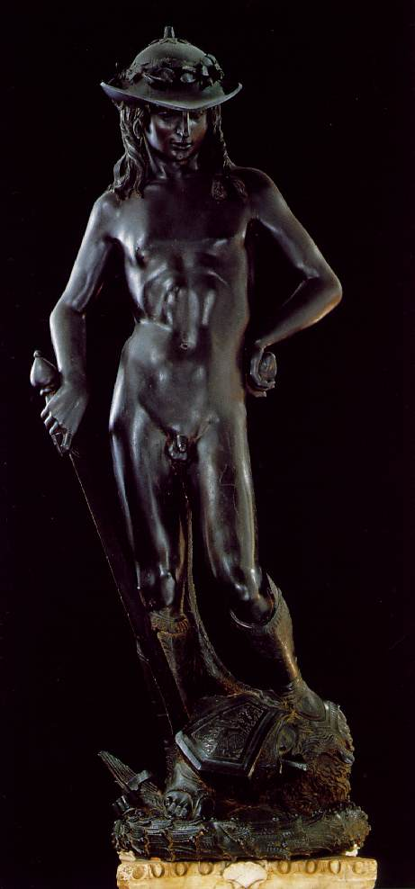
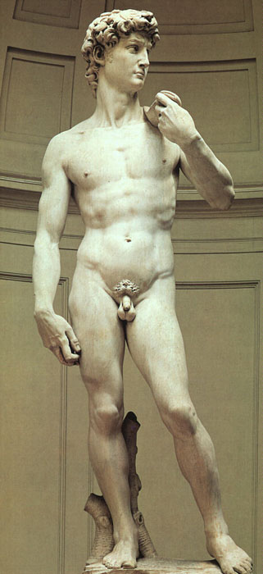
← 1440
What a difference a century makes!
1501-1504 →

Slide 23
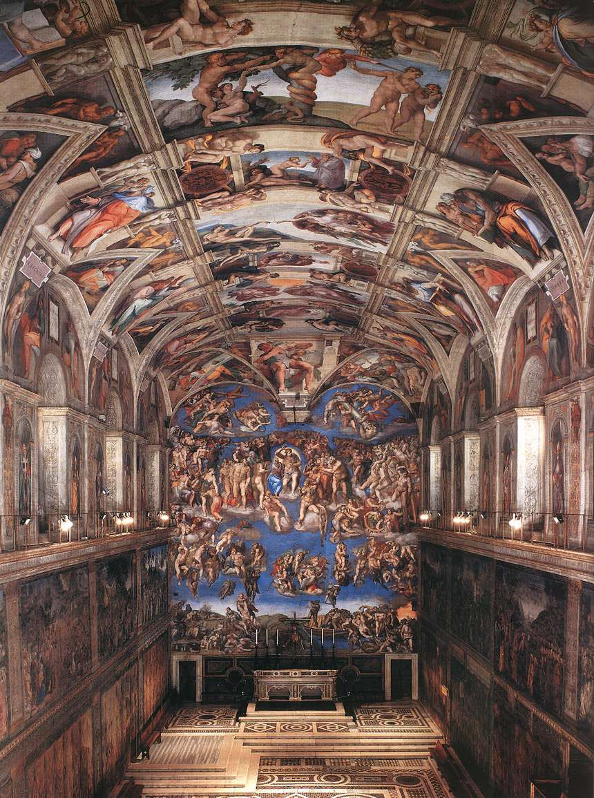
The Sistine Chapel Michelangelo Buonarroti 1508 - 1512

Slide 24
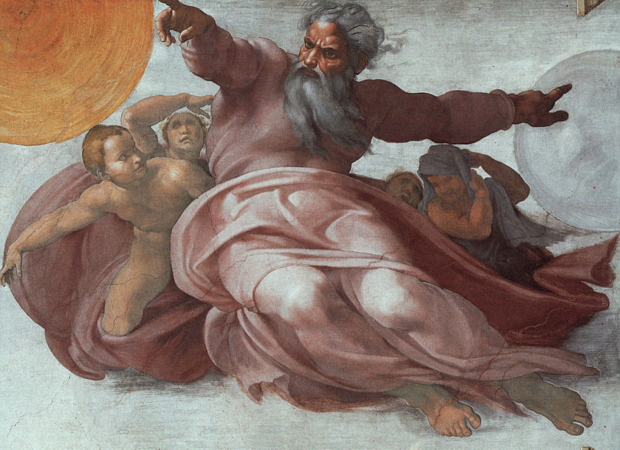
Sistine Chapel Details
Creation of Heavens

Slide 25
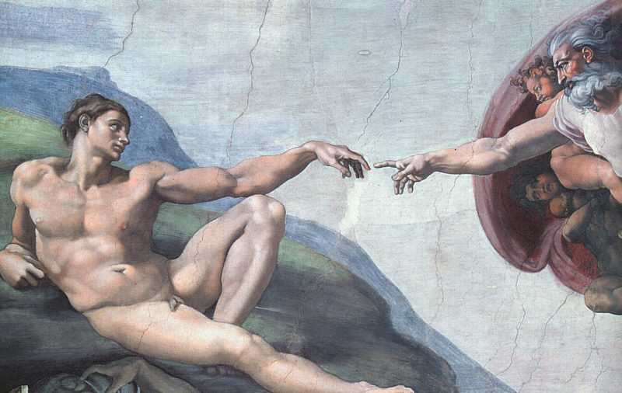
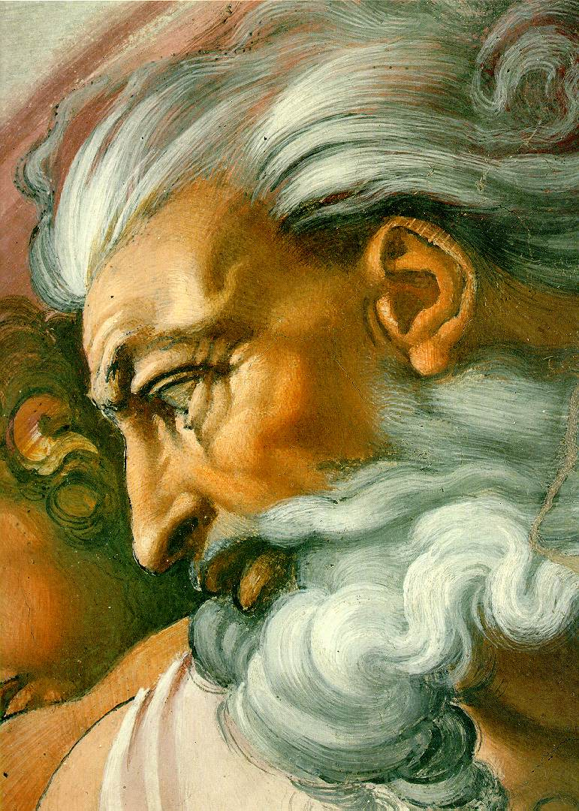
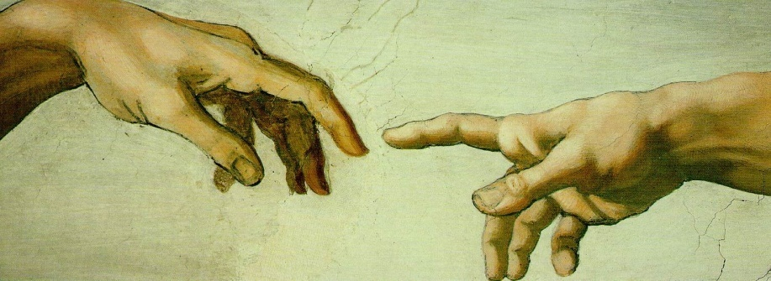
Sistine Chapel Details
Creation of ?

Slide 26
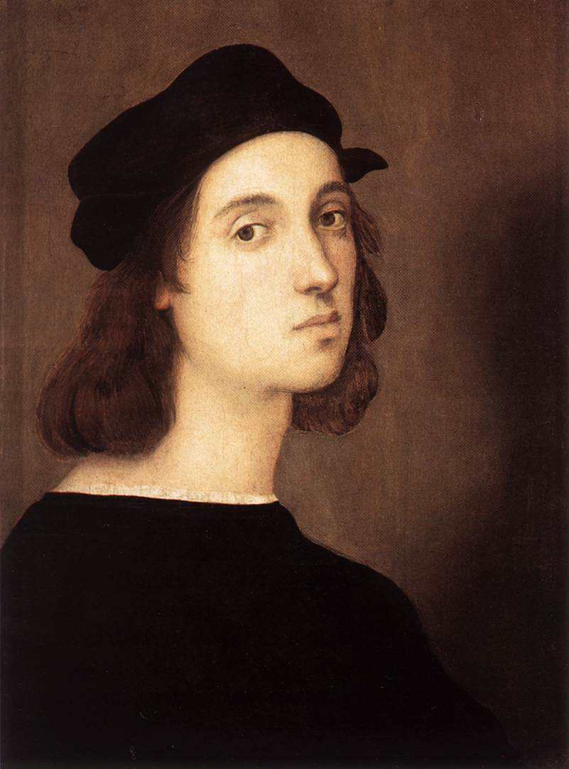
Raphael
Renaissance Art – Realism &
Expression
-Linear perspective
Greatest Work:
The School of Athens
Painted Renaissance Figures
such as himself, Michelangelo,
da Vinci as classical
philosophers & students
Self-Portrait, 1506

Slide 27
The School of Athens – Raphael, 1510 -11
Important Greek philosophers & thinkers papal apartments library of Vatican.
Located in
Raphael worked on this at same time Michelangelo did Sistine Chapel.
No Christian themes here but commissioned by a Pope

Slide 28
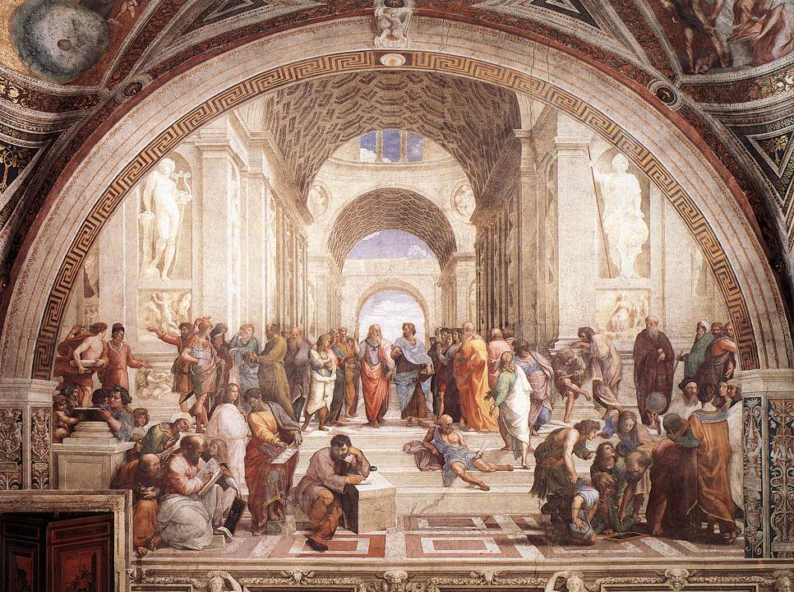
The School of Athens – Raphael, 1510 -11
Da Vinci
Raphael
Michelangelo

Slide 29
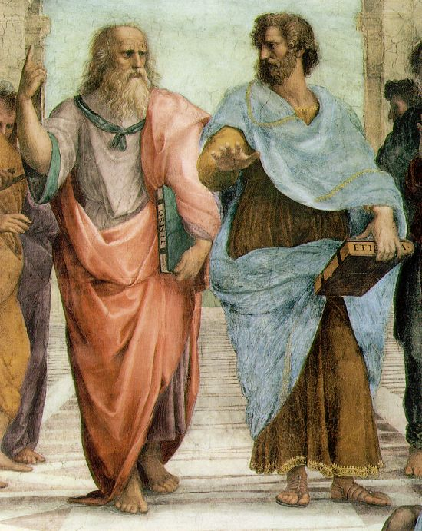
The School of Athens - Detail
Plato: points to heavens (IDEAL)
Aristotle: looks to earth (here and now)

Slide 30
Recap
What elements from the Renaissance can you find in major cities such as Chicago, Illinois today?
Where can you uncover these elements/characteristics?

