Slide 1

The Protestant Reformation

Slide 2
What was the Protestant Reformation?
Prior to the Reformation all Christians were Roman Catholic
The [REFORM]ation was an attempt to REFORM the Catholic Church
People like Martin Luther wanted to get rid of the corruption and restore the people’s faith in the church

Slide 3
What was the Protestant Reformation?
CHRISTIANITY
CATHOLIC
PROTESTANT

Slide 4
The Reformers
Martin Luther
John Calvin
Henry VIII

Slide 5
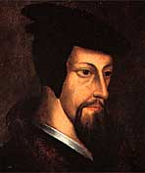
John Calvin
Anti-Catholic
Influenced by Martin Luther
Disagreed with Luther’s “Salvation through faith alone.”
Created his own Protestant religion in Switzerland

Slide 6
Luther's 95 Theses
A list of things he thought were wrong with the Catholic Church (95 Complaints)
He criticized:
  The Power of the Pope
  The Extreme Wealth of the Church
  Indulgences (Catholic concept of Salvation)

Slide 7
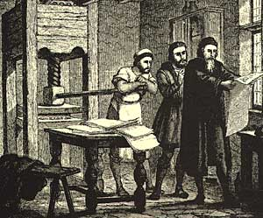
Luther's 95 Theses
Gutenberg’s Printing Press made it possible for Luther to spread his beliefs
Posted his 95 Theses on Church doors in Germany
Gained support from people and criticism from Church

Slide 8
Predestination
Calvin believed in:
  Salvation through Predestination
    At birth it is decided if you will go to heaven or hell

Slide 9

Calvin believed in:
  Foreknowledge
    God knows everything that will happen in your life
  Purified approach to life:
    No drinking, swearing, card playing, gambling etc..

Slide 10
Christianity
Catholic
Protestant
Lutheran
Calvinism
Presbyterian
Puritan
Hugeunots

Slide 11
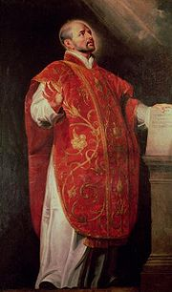
The Catholic Reformation
Ignatius of Loyola
  Founded Jesuit Order
    Combated Heresy
    Spread Catholic Faith
    Disciplined, Well- Trained, and Obedient
  Jesuits Fought the Reformation
    Became Advisors to Monarchs
    Created Religious Schools
    Became Missionaries
Ignatius of Loyola

Slide 12
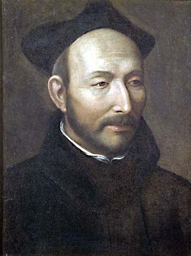
Catholic Reformation
Also known as Counter Reformation
Ignatius of Loyola - formed Society of Jesus - Jesuits - founded schools in Europe, sent out missionaries throughout world, worked to stop spread of Protestantism
Ignatius of Loyola

Slide 13
The English Reformation
Breaking With the Church
  Parliament passed the Act of Supremacy in 1534
    Declared the king was the head of the Church in England
  Henry married Anne Boleyn and had another daughter, Elizabeth.
Notes:
The Act of Succession, passed by Parliament , declared the marriage between Henry and Anne valid, which legitimized Elizabeth as heir to the throne. Mary Tudor was declared illegitimate, which meant she could not inherit the throne.

Slide 14
The English Reformation
Strengthening the Church of England
  Many Catholics who opposed the Act of Supremacy were tried for treason and executed
  The English government seized wealth and land owned by Catholic churches and monasteries
  Still, the Church of England resembled the Catholic Church in its religious beliefs and practices

Slide 15
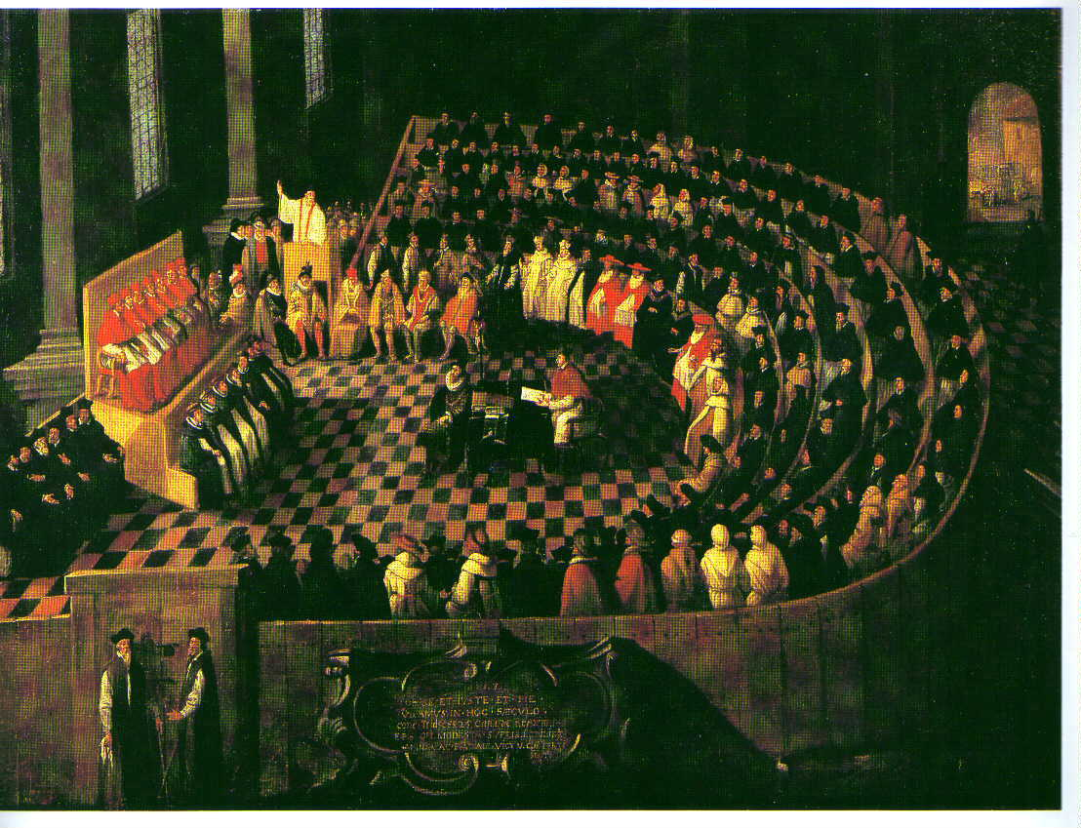
Council of Trent
Agreed on by Catholic bishops & cardinals
Church’s interpretation is Bible is final
Salvation on both faith & good works
Bible & Church traditions important for guiding life
Indulgences were ok, but not false selling of them
Council of Trent

