Slide 1
The Persian War

Slide 2
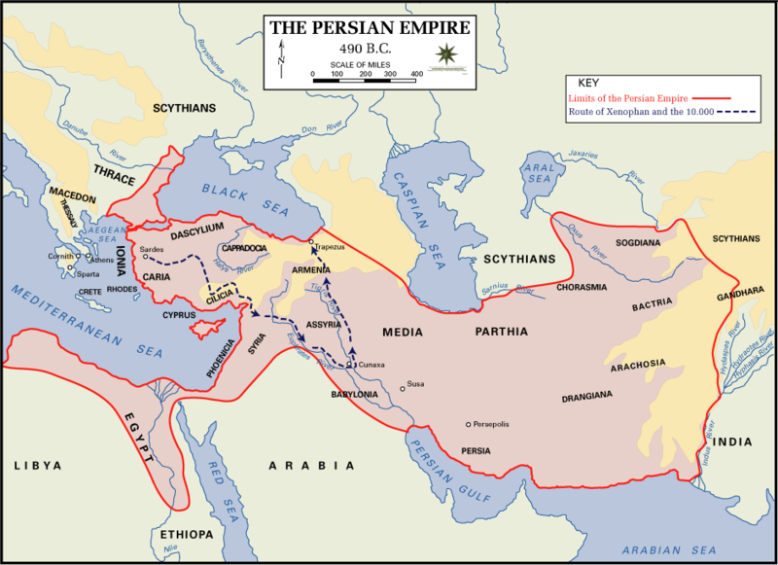

Slide 3
Persians Invade, Lose a Marathon
Persians Enter and Invade Greece from the south & conquer (around 550 BC)
Conquered Greeks eventually revolt
Athens sends aide, angers Persia (around 499 BC)
Meet for battle in Marathon (around 490 BC)
10,000 Greeks Vs. 25,000 Persians, Greeks Win!
Officially ends first Persian Invasion of Greece
Inspires myth of Greek messenger

Slide 4
Victory
The Greek Navy takes a large role in defeating the Persians
Final battle would come at the Battle of Platea where the smaller, but better armored Greek soldiers slaughtered Persian infantry

Slide 5
Victory and Consequences…
Greek city-states unite to form the Delian League under Athenian Leadership
Athens gains for control
Ward of future Persian attacks
Uses military strength against anyone who challenged
Became more of an Athenian Empire than league
Athens enters its golden age

Slide 6
The Golden Age of Athens
Pericles takes charge 461-429 BC:
Three Goals
1. Hold and Strengthen The Empire
Beefs up navy
Why?
2.Stronger Democracy
Created paid positions within government
Why does this help?
Direct Democracy established
3. Glorify Athens
Beautify it with art and architecture!

Slide 7
The Delian League

Slide 8
The Delian League
Founded in 477 BC under leadership of Athens
Purpose: Continue fighting the Persian Empire, protect Greece
Originally met in Delos (hence the name), but Pericles moved it to Athens in 454
…Why do you think?
League members had to pay “dues”
Originally men, boats, and weapons
Switched to $$$
Athens would use the league for it’s own purposes
Financing
Regulating/Controlling Commerce
Building a wall to make it invincible from land invasion
From who?

Slide 9
Socratic Questioning
A form of debate the features asking and answering questions to stimulate critical thinking and to illuminate ideas
“Distilling” a more logical belief
Socrates is credited with inspiring the scientific method

Slide 10
Scientific Method VS. Socratic Method
Scientific Method | Socratic Method
1. Pose a Question | 1. Pose a Question
2. Hypothesis--- Empirically measured | 2. Hypothesis --- Intuitively/Logical measured
3. Experiment--- Perform an experiment to see if conditions in #2 are observable. If so, go to #4, if not, go back to #2. | 3. Testing/Cross Examination--- If a situation is logical based on #2, move on to #4. If not, rethink #2.
4. Accept the hypothesis as provisionally true. Return to step 3 if there other predictable consequences of the theory which have not been experimentally confirmed. | 4. Accept the hypothesis as provisionally true. Return to step 3 if you can conceive any other case which may show the answer to be defective.
5. Act Accordingly | 5. Act Accordingly

Slide 11
Plato and Aristotle
Plato
Aristotle
Student of Socrates
Socrates refused to write anything, so Plato did
Why could that be problematic?
Wrote “The Republic” and envisions the perfect governed society
Believed that the person with the greatest insight and intellect would be the philosopher-king
Questioned the nature of the world and of human belief, thought and knowledge
Nearly summarized all of the knowledge up to his time
Promotes a moderate course between extremes
Created the basis of the scientific method
Taught Alexander the Great

Slide 12
Drama and History
Tragedy and Comedy
Tragedy: A serious drama
Heroes with tragic flaws
Comedy: Slapstick situations and crude humor
Often made fun of politicians and ideas of the time
Herodotus pioneers historical writing
Wrote on the Persian Wars
Thucydides coins the feeling that history repeats itself and by studying history it allows you to understand the present

Slide 13
Athens VS Sparta
Athens was expanding it’s empire in the Delian League
Weak Army
Sparta responds by creating the Peloponnesian League
No Navy
Army VS Navy
Who do you think has the advantage?

Slide 14
The Peloponnesian War
Sparta doesn’t appreciate Athens’ growing power but they didn’t initiate battle, colonies & allies did (a recurring theme in history)
Sparta surrounds Athens, Athens blockades Sparta, epic stalemate occurs
Athens suffers through terrible plague
Kills 1/3 population, including Pericles

Slide 15
The Fall of Athens
Athens tries to invade Siciliy but fails, weakening itself
Athens falls victim to the plague losing 1/3 of population and Pericles
Sparta builds a Navy, kicks butt
War lasted nearly 30 years
Sparta actually got support from Persia!
Athens lost:
Fleet
Empire
Power
Wealth
Self-Confidence
Socrates?
Greece lost:
Unity
Cohesive leadership

Slide 16
Enter Alexander the Great
Macedonia was looked down upon by Greece
King Philip II of Macedonia becomes king and quickly invades Greece in 338 BC.
Took advantage of weakness after Peloponnesian War
Urged by Athenian philosopher to unite Greece, Fight Persians
Greek city-states argued too much over how to handle his growing army

Slide 17
Alexander VS Everyone
King Philip is murdered, Alex takes over
Alexander the Great:
Educated by Aristotle
Intent on ruling Greece and Punishing Persia
When Thebes revolts, he burns it to the ground (Greece reacts by surrendering)
Liberates Greek colonies on the west Coast
“Unties” the Gordian knot

Slide 18
Alexander VS Everyone
Alex Invades the Persian empire
Smashes through the larger Persian empire army soundly defeating it
Offered a deal for a piece, instead decides he wants the whole thing
Liberates Egypt, made Pharaoh (Found Alexandria)
Sweeps into Mesopotamia and whomps Darius again
Darius is assassinated by his own
Alex marries a few princesses, moves towards India (but his troops decide not to after being on the road for 8 years)
Later contracts a fever, dies

Slide 19
Legacy of Alexander the Great
Empire gets split up 3 ways
Ignored democratic traditions
A new culture was created out of Alex’s mixing of his conquered lands
Egyptian, Greek, Persian, and Indian cultures blended to create the Hellenistic Culture

Slide 20
Alex-chievements!
Alexandria
Center of Hellenistic Civilization
Thrived economically, artistically, academically (museum and library)
Astronomy
Geography
Mathematics
Physics
Sculpture
Hellenism
Women get higher status

Slide 21
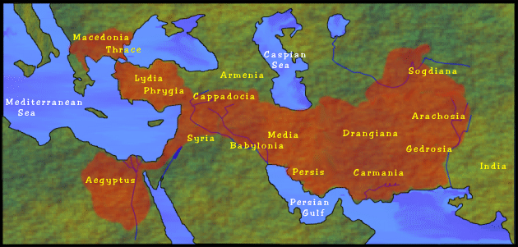

Slide 22
Mediterranean Fight Club
Round 1: Greeks VS Persians (Darius)
Cause?
Effect?
Round 2: Greeks VS Persians (Xerxes)
Cause?
Effect?
Round 3: Sparta Vs Athens
Cause?
Effect?
Round Four: Macedonians and Alex Vs. Everyone
Cause?
Effect?

Slide 23
Mediterranean Fight Club
Round 1: Greeks VS Persians (Darius)
Persian War, Round 1
Darius The Great invades, loses at Marathon
Winners: Athenians
Round Two: Greeks Vs Persians (Xerxes)
Persian War, Round 2
Xerxes brings back a HUGE army
Xerxes VS Leonidas
Xerxes VS United Greece
Winners: United Greece
Round Three: Athens VS Sparta
Peloponnesian War
Club Vs Club
Winners: Sparta
Round Four: Macedonians & Alex VS Everyone
Macedonians VS. Greece
Alexander VS The World
Winner: Alex
Round Five: Alex Vs. Flu
Winner: Flu
Losers: His empire

