Slide 1
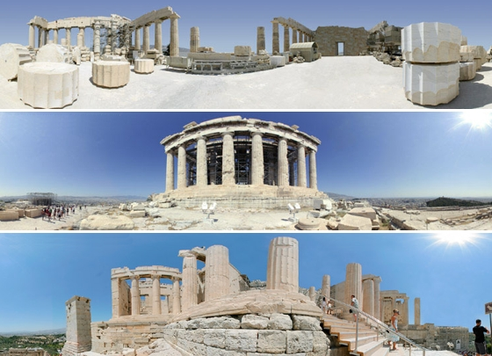
Ancient Greece

Slide 2
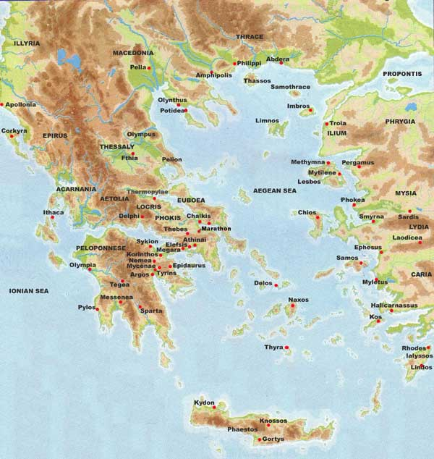

Slide 3
A Culture Created by the Land and the Sea
The Sea:
Very dependent and very influenced by the Mediterranean Sea
The seas and water linked most of Greece
Traded with and traveled to areas of Asia, Egypt, other parts of the Mediterranean
Greeks became proficient sailors
Based on the geography, why was trade and sea travel so important to Greeks?

Slide 4
The Land
Rugged, mountainous peninsula
Mountains divided the land into many different regions
Olympia to Sparta= 60 miles
Took nearly a week to get there
Developed small independent communities within each valley
Difficult to travel via land
Not a lot of arable, or farmable, land
What do you think this will do to the population?
Comfortable climate allowed for much outdoor life and social gatherings

Slide 5
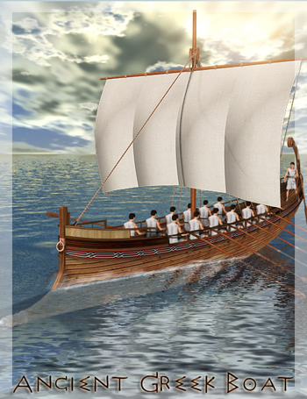
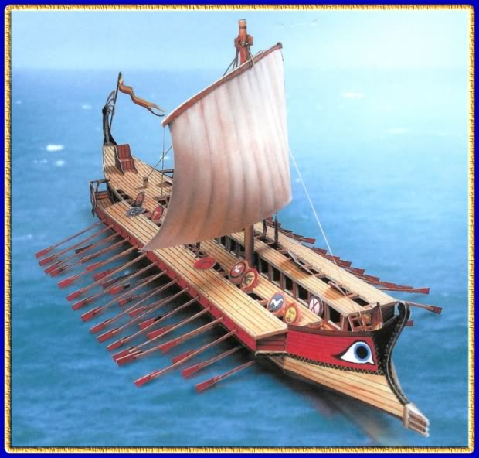

Slide 6
Knowing the Minoans
Contact with the Minoans, through trade or war, Mycenaeans saw value in seaborn trade
Began trading with Aegean islands, Anatolia, Syria, Egypt, Italy, and Crete
Minoans loaned their writing system, art, religion, politics and literature

Slide 7
Existed between 1600-1500 BC, disappears around 1400 BC
Traded with lands as far as Egypt and the Mesopotamia
It’s suggested that women had a greater role in society
Likely wiped out by the Mycenaeans

Slide 8
Of Mycenaean and Men (Bronze Age)
Indo-Europeans settled in Greek around 2000 BC, dominated around 1400-1200 BC
Combined knowledge and culture from Minoans, Egyptians, and Mesopotamians
Each city-state was a well fortified city ruled by a warrior king

Slide 9
The Trojan War
A legendary war based around a Trojan prince kidnapping Helen, the wife of the king of Mycenae
The king would lead Greek troops to troy and lay siege on the city for 10 years before using the Trojan Horse ruse to enter the city and slaughter those within
Fact or fiction?
Ancient Greeks: Fact
Modern scholars: At one point, fiction! Now, FACT!

Slide 10
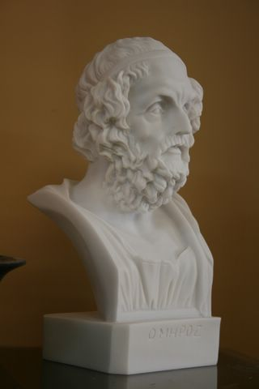
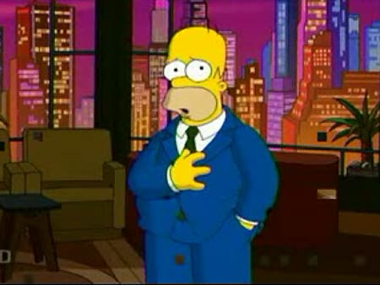
How History Teachers Were Born
The Mycenaean civilizations fell from sea raiders attacking
Dorians moved in but were far less advanced
The art of writing was temporarily lost (1150-750 BC)
Because writing was lost, Greeks began getting their history through spoken word
One of the best known story tellers was Homer (750-700 BC)

Slide 11
That's Epic
The Iliad tells the story of Achilles, Hector, and Helen and the Greek heroic ideal of virtue and excellence
Also told the Odyssey of Odysseus and his long journey home after the Trojan War
The Greeks also create a rich set of myths and stories about Gods
Myths helped them understand the mysteries of nature and the power of human passions

Slide 12
Government, Greek Style
Monarchy
Single person ruling
Tyrants
Powerful individuals who seized power
Not all that bad
Aristocracy
Government run by a small group of noble, landowning and wealthy families
Oligarchy
Run by a few powerful people
In Athens, people began leaning towards Democracy to run things
621 BC, Draco passes a law where everyone is equal
594 BC, Solon outlaws slavery, allows all citizens regardless of class to participate in the Athenian assembly
500 BC, Cleisthenes breaks up power of nobility and organizes citizens based on where they live. All citizens can suggest laws
Only adult male landowners could vote

Slide 13
A Tale of Two City-States
Athens
Sparta

Slide 14
Government
Athens
Sparta
Limited/Direct Democracy
Not everyone was considered a citizen
Developed over time by Solon, Cleisthenes, Pericles, and others
Varied between the various forms of rule
Completely devoted to military
Military-State
Dual Monarchy
Power to make war
Priestly obligations
Oligarchic
28 members chosen for life + 2 Kings
5 members elected annually held main power (Ephors)
Democratic
Spartan citizens

Slide 15
Social Structure
Athens
Sparta
Citizens
Free, native males were upper class
Slaves
Women
Spartiati
Citizens of Sparta (earned, minority)
Helots
Messenians conquered by the Spartans
“Slaves” to the Spartans
Often rebelled

Slide 16
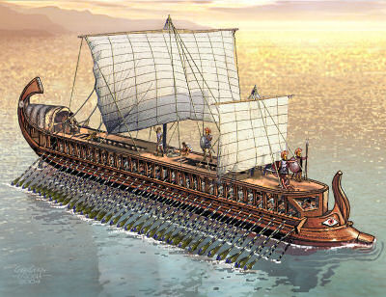
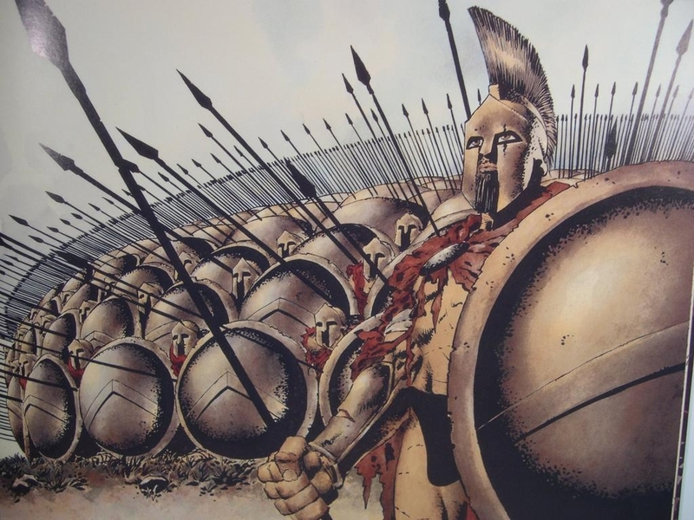
Military
Athens
Spartan
Navy
Strength on the seas
Army
Strength on the lands (would later change)
Phalanx

Slide 17
Lifestyle and Values
Athens
Sparta
Democratic
Arts, philosophy, education, culture, debate, politics, commerce
Completely militaristic values
Partially to keep Helots in control
Boys sent at Age 7 to begin 13 years of military training
Devoted to the state

Slide 18
Education
Athens
Sparta
Boys:
Received the most education
Valued Athletics
Girls:
Very little education (basics)
Not allowed to participate in sports
Boys:
Valued Athletics
Received education through military training
Girls:
Valued athletics
Strong parents breed strong children
Valued Education
Often had same duties and rights as men
Owned property

Slide 19
Role of Women
Athens
Sparta
Little to No participation in politics
Rarely left house
Very conservatively dressed
Limited but some role in politics
Nearly equal status given to women
When asked by a woman from Attica why Spartan women were the only women in the world who could rule men, she replied "Because we are the only women who are mothers of men"

Slide 20
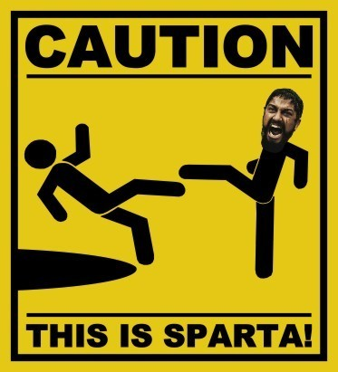
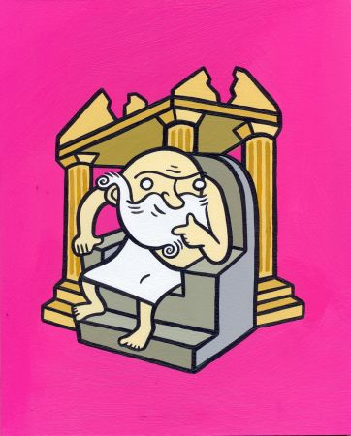
Cultural Achievements and Legacy
Athens
Sparta
Olympics
Art and Architecture
Philosophy
Democracy
Education
Efficient Military State
Discipline
300 Legend
Battle of Thermopylae

