Slide 1
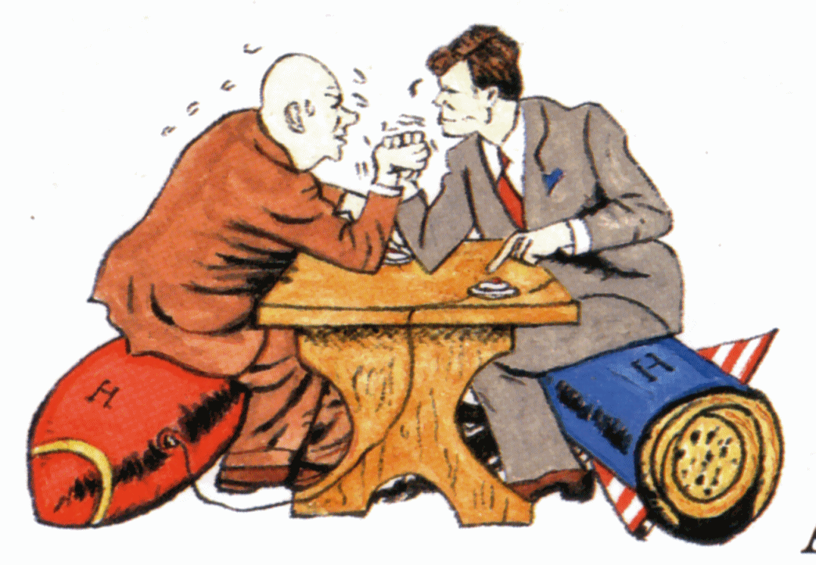
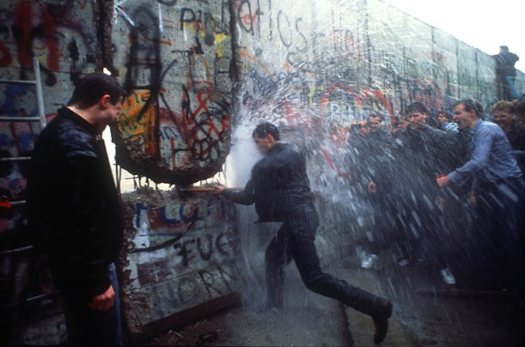
COLD WAR TIMELINE
The onset of the Cold War marked the beginning of the modern era. The Cold War was the period of conflict, tension and competition between the United States and the Soviet Union and their allies from the mid 1940s until the early 1990s. Throughout the period, the rivalry between the two superpowers was played out in multiple arenas: military coalitions; ideology, psychology, and espionage; military, industrial, and technological developments, including the space race; costly defense spending; a massive conventional and nuclear arms race; and many proxy wars.

Slide 2
Your Timeline Task
Since the Cold War is spans over 40 years and incorporates many extremely important historical events, it is important that we organize this history to visualize the Cold War in its entirety.
It is your task, using your book (Chapter 30) and online resources to create a timeline of the Cold War.
Your timeline must include
15 events that span the entirety of the Cold War(1945-1991)
A visual that represents each event

Slide 3
U.S. Policy
Brinkmanship
Edge of all out war
Nuclear weapons and the air force
“Duck and Cover”
H-BOMB
C.I.A.
Spies and coups

Slide 4
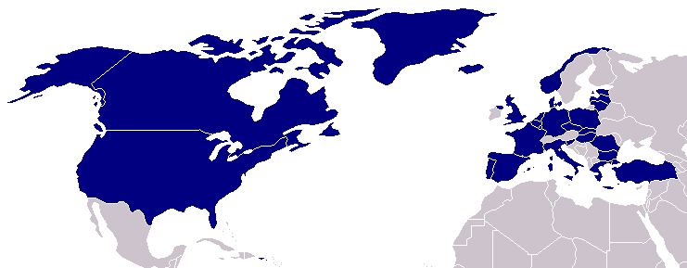
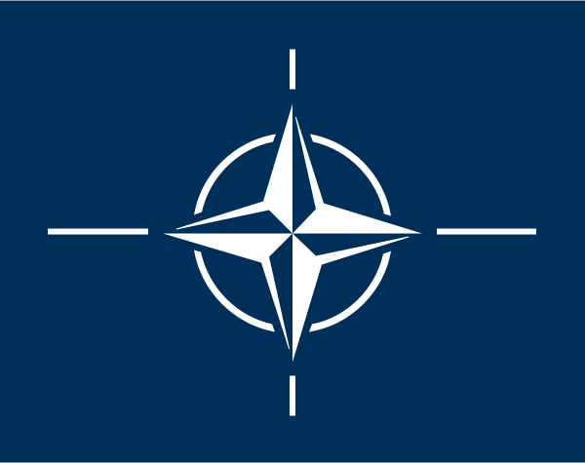
North Atlantic Treaty Organization (1949)
United States
Belgium
Britain
Canada
Denmark
France
Iceland
Italy
Luxemburg
Netherlands
Norway
Portugal
1952: Greece & Turkey
1955: West Germany
1983: Spain

Slide 5
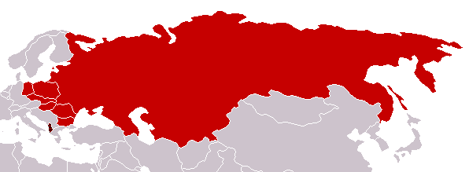
Warsaw Pact (1955)
U. S. S. R.
Albania
Bulgaria
Czechoslovakia
East Germany
Hungary
Poland
Rumania

Slide 6
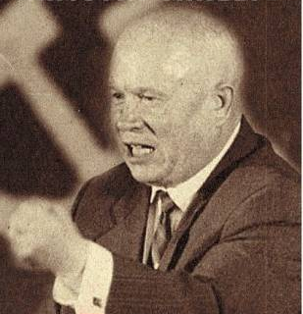
Premier Nikita Khrushchev
About the capitalist states, it doesn't depend on you whether we (Soviet Union) exist. If you don't like us, don't accept our invitations, and don't invite us to come to see you. Whether you like it our not, history is on our side. We will bury you. -- 1956
De-Stalinization Program

Slide 7
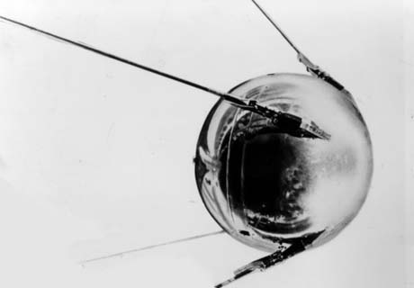
Sputnik I (1957)
The Russians have beaten America in space—they have the technological edge!

Slide 8
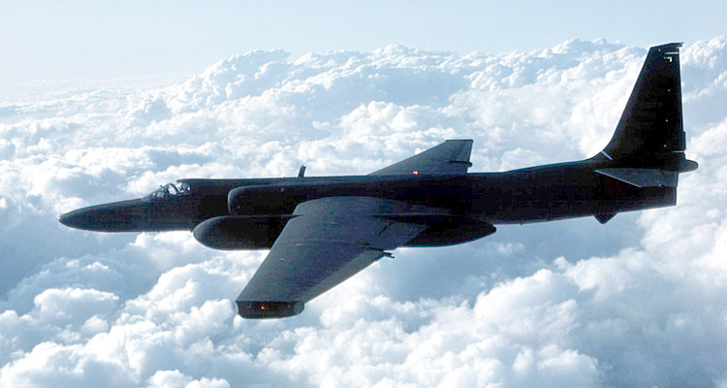
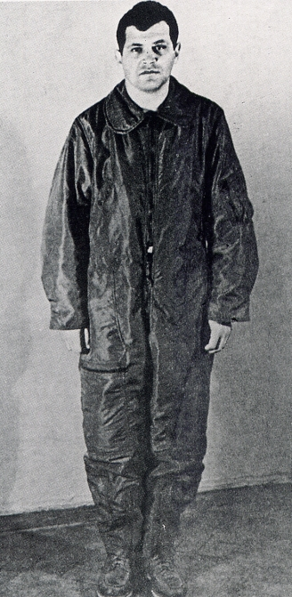
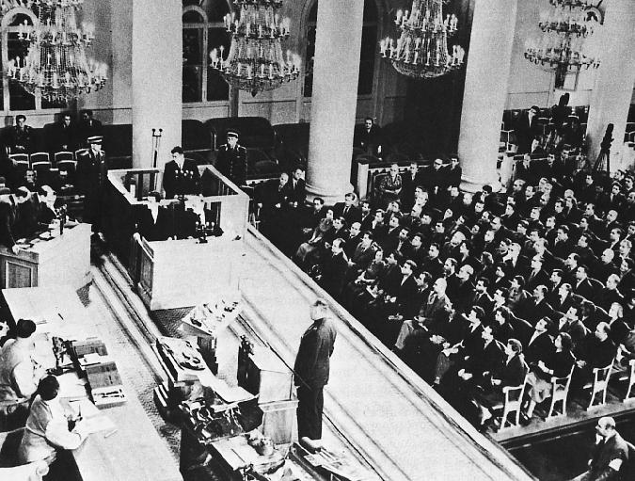
U-2 Spy Incident (1960)
Col. Francis Gary Powers’ plane was shot down over Soviet airspace.

Slide 9
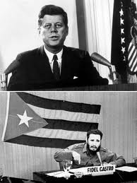
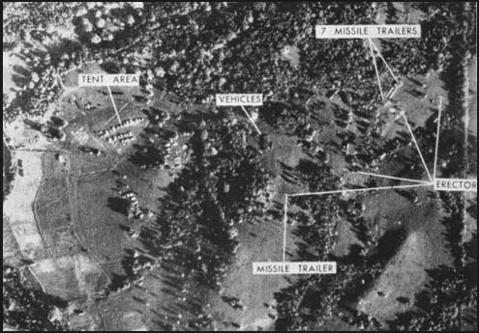
Kennedy and the Cold War
Flexible Response
Fidel Castro comes to power
Accepts Soviet aide
The Bay of Pigs
Failure and embarrassment
Cuban Missile Crisis

Slide 10
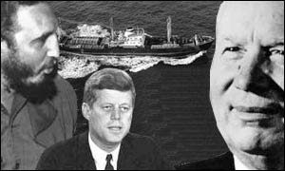
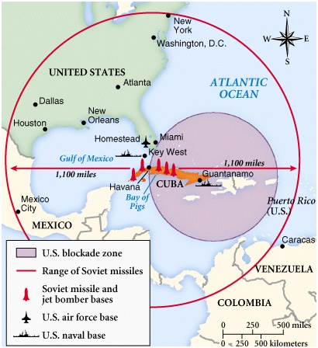
Cuban Missile Crisis (1962)

Slide 11
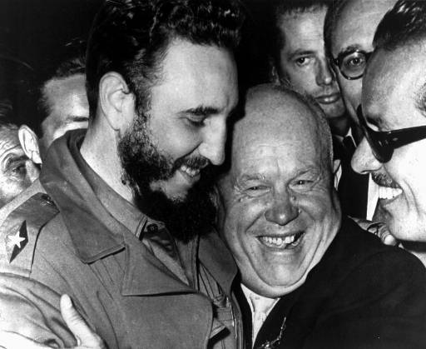
Khruschev Embraces Castro, 1961

Slide 12
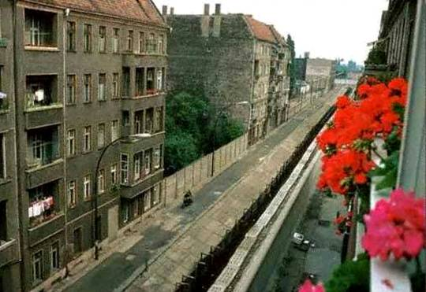
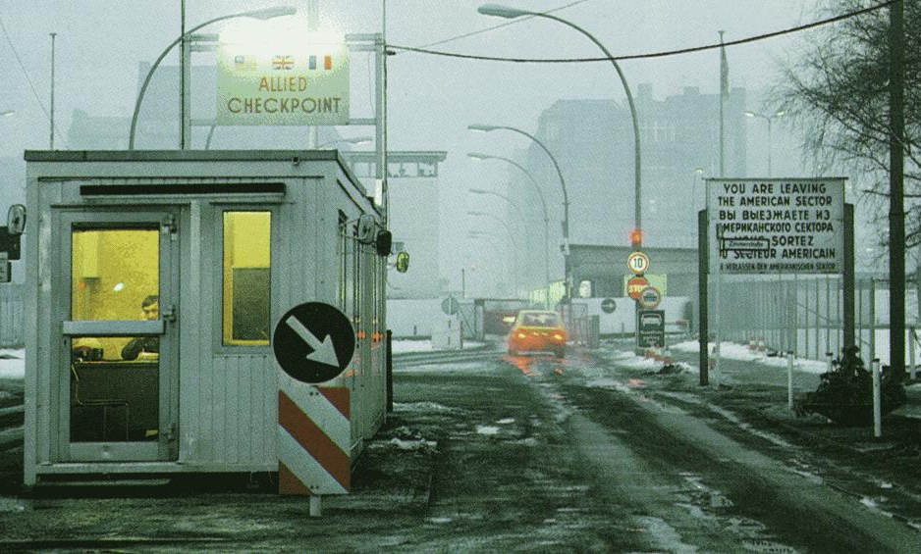
The Berlin Wall Goes Up (1961)
Checkpoint Charlie

Slide 13
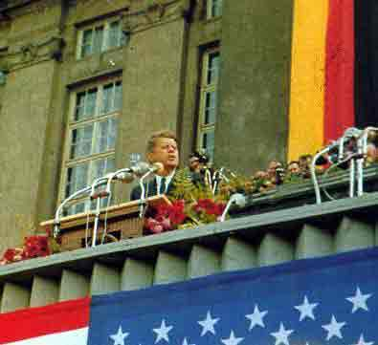
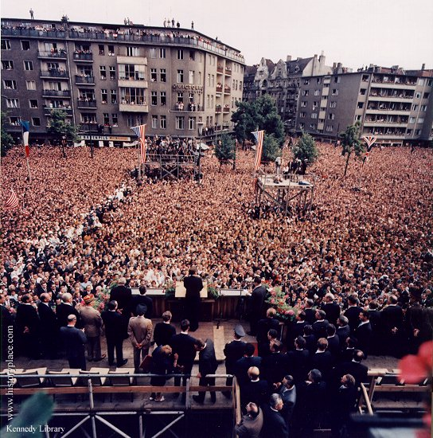
Ich bin ein Berliner! (1963)
President Kennedy tells Berliners that the West is with them!

Slide 14
The Berlin Wall
East Berliners flee to West Berlin to escape communism…
Khrushchev threatens to close off at routes to West Berlin
US determination and nuclear power stops Khrushchev from closing off access to West Berlin
Instead Khrushchev builds the wall to stop these refugees and keep East Berlin strong
Crisis averted but tensions rise
Symbolic meaning?

Slide 15
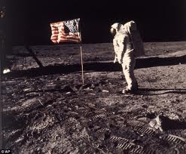
Space Race
Kennedy responds to Gagarin in space…
NASA
1969 Neil Armstrong first man on the moon
What does this symbolize?
What do you think the affects were?

Slide 16
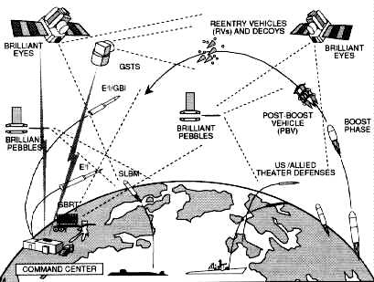
Regan and the Cold War
Strategic Defense Initiative aka “Star Wars” -1983
MX Missile
B1 Bomber
In theory effective but did not pan out

Slide 17
End of the Soviet Era
Gorbachev comes to power
Glasnost and Perestroika = less government control of economy, democracy
INF Treaty
Nationalist sentiment in USSR
Countries become independent and can develop their own governments
Berlin wall collapses in 1989
Symbolic end

